Slide 1
Sprint Project
Brandon Garsson & Jake Feldstein

Slide 2
Challenges Faced
-Finding time to test in classroom
-Robot malfunctions (not turning on/not connecting)
-Failure to stay on track during testing
-Failure to make last turn several times
-Code readjustments
-Trouble deciding whether to keep cover on/off

Slide 3
Team Roles
Jake- Robot sign-out, Recording of Data, Gantt Charts, Testing & Documentation
Brandon- Developing code, Group communication, Testing, robot maintenance, group leader

Slide 4
What we learned about software engineering
-Minor mistakes can make a big difference when it comes to programming. It takes much trial and error to find out exactly what to tell the program to get the desired outcome.
-This can relate to programming larger machines such as drones or precision rockets that could have a catastrophic outcome if it does not perform exactly as intended.

Slide 5
What we would do differently
-Find out when classes were held in HH 208 to plan test times accordingly.
-Measure the dimensions of the track and replicate it in an environment that is easier to access on a daily basis ( dorm building / library ).

Slide 6
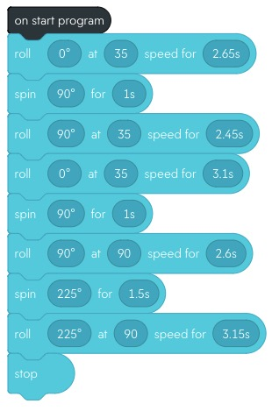
Sprint 3 - Agility Code

